Slide 1
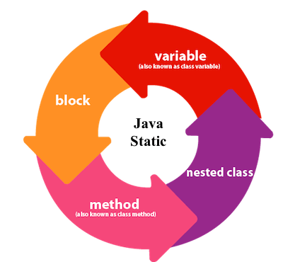

Slide 2
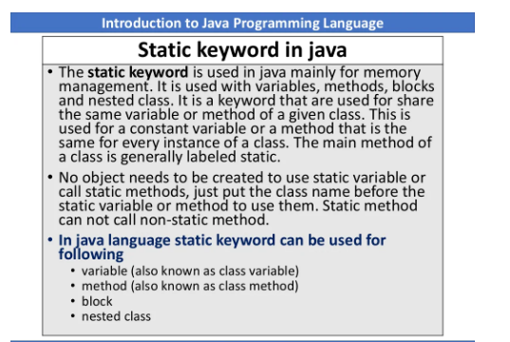

Slide 3
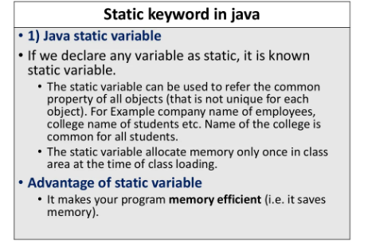

Slide 4
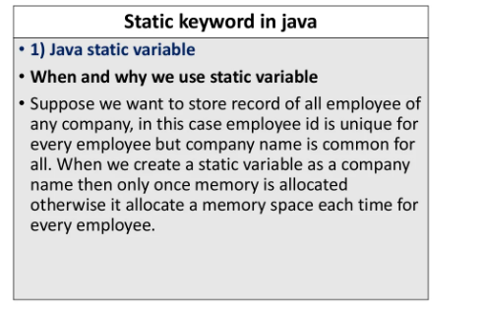

Slide 5
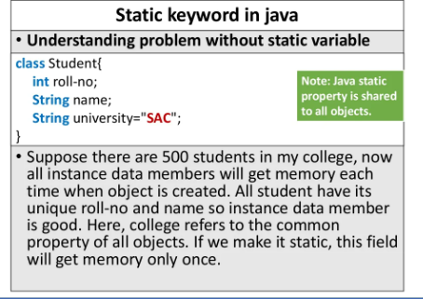

Slide 6
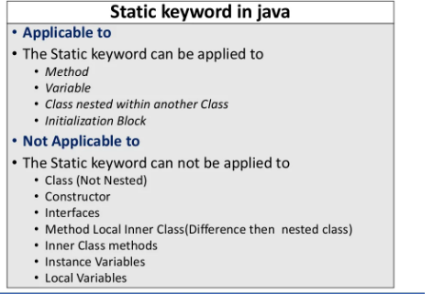

Slide 7
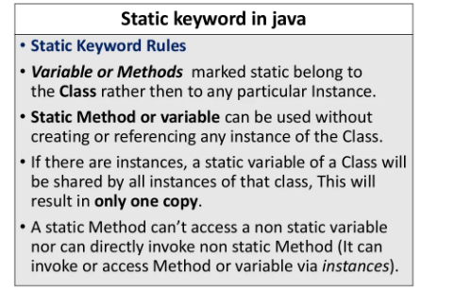

Slide 8
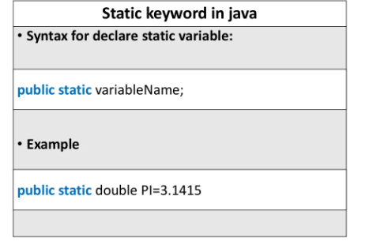

Slide 9
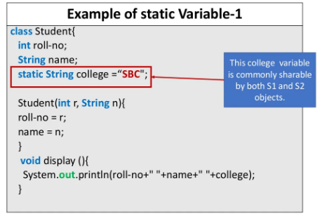

Slide 10
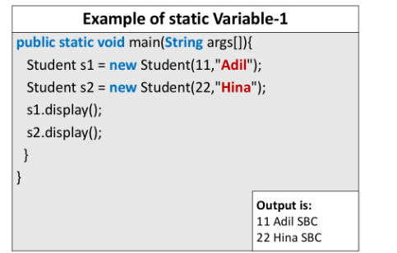

Slide 11
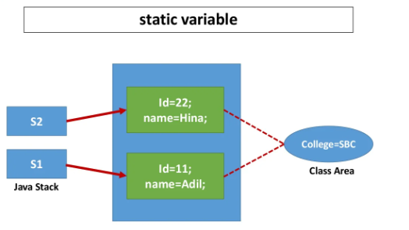

Slide 12
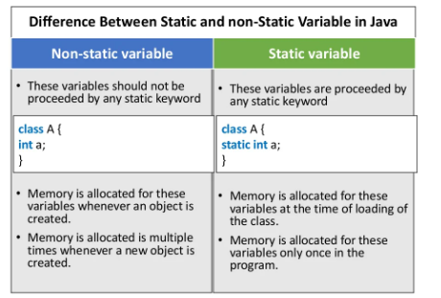

Slide 13
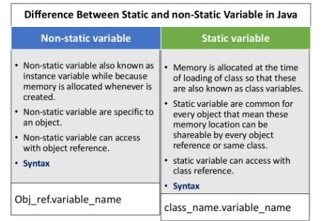

Slide 14
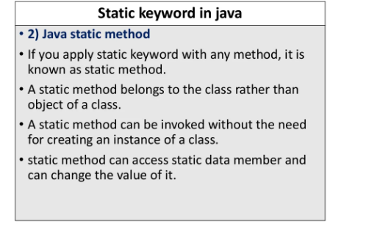

Slide 15
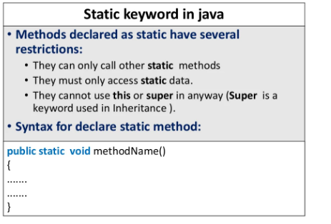

Slide 16
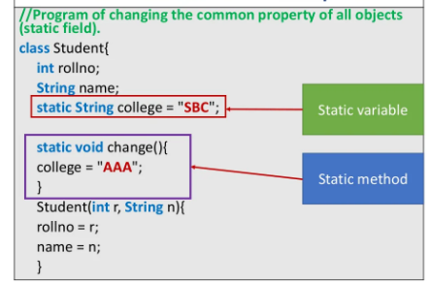

Slide 17
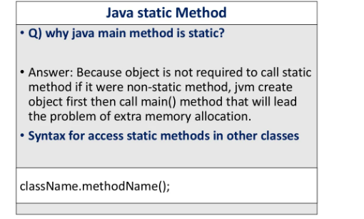

Slide 18
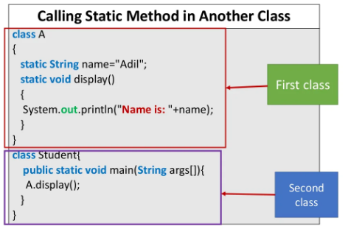

Slide 19
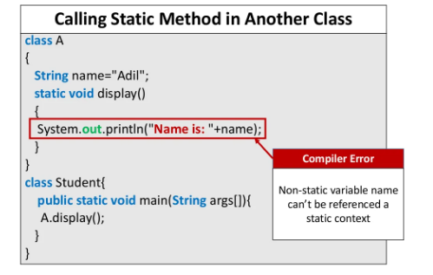

Slide 20
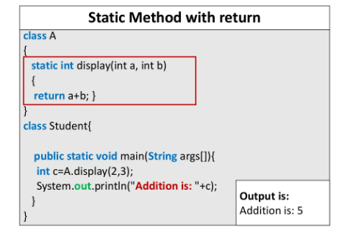

Slide 21
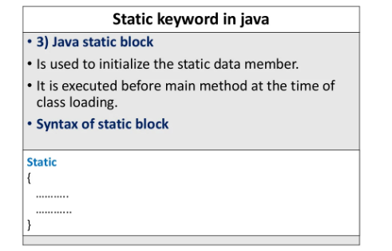

Slide 22
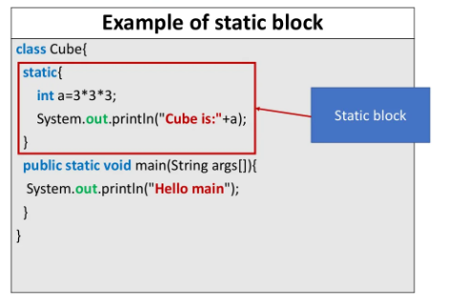

Slide 23
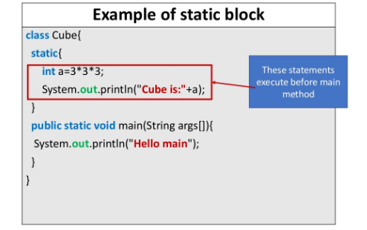

Slide 24
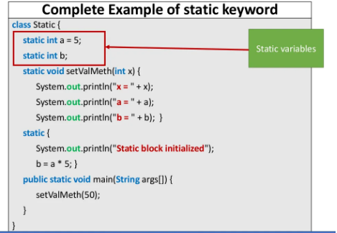

Slide 25
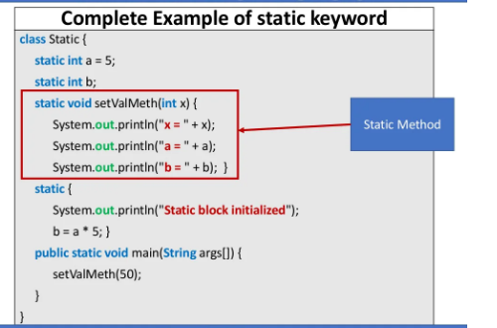

Slide 26
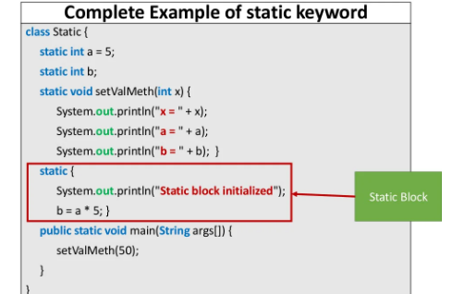

Slide 27
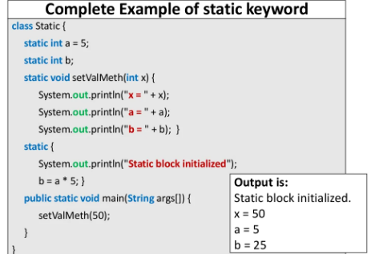

Slide 28



Slide 29




Slide 30
Public class Student
{
Static void display()
{
System.out.println(“hello”);
}
Void newDisplay()
{
System.out.println(“hello hai”);
}
Public static void main(String args[])
{
Student.display();
}
}

Slide 31
Public class Student
{
Static void display()
{
System.out.println(“hello”);
}
Void newDisplay()
{
System.out.println(“hello hai”);
}
Public static void main(String args[])
{
Student.display();
Student obj=new Student();
Obj.newDisplay();
}
}

Slide 32
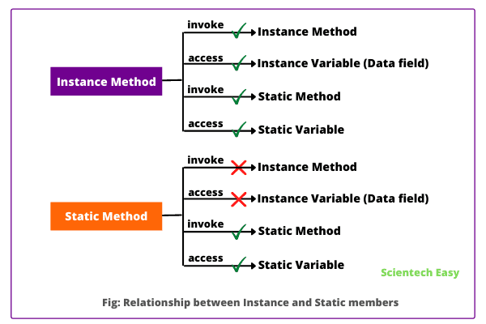

Slide 33
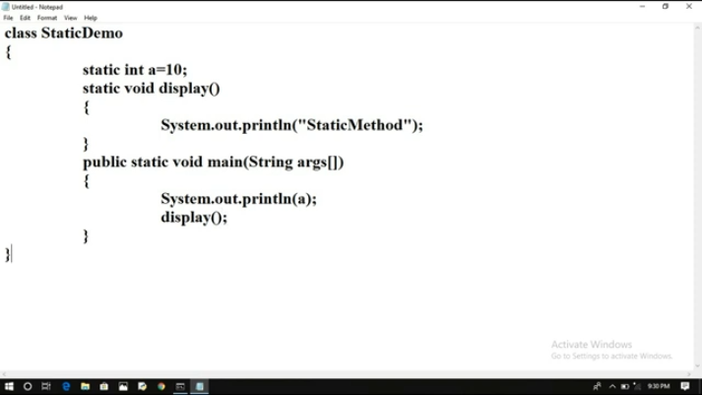
Static method and variable in the same class(directly we can access)
Output: 10
Static Method

Slide 34
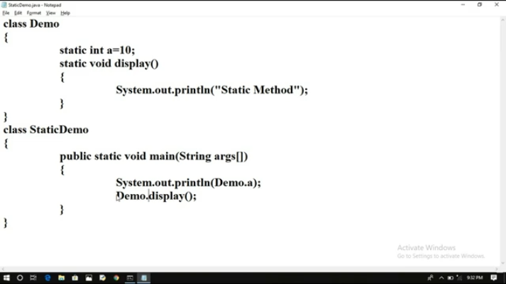
Static method and variable in the different classes
Output: 10
Static Method

Slide 35
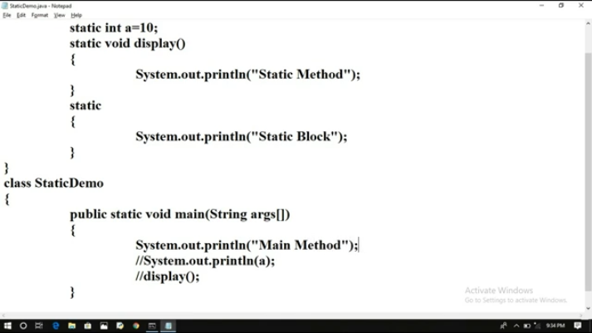
Static block without reference
Output: Main Method

Slide 36
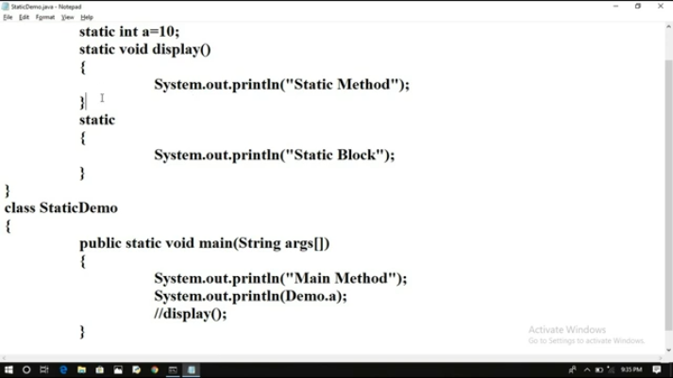
Static block with reference
Static Block
10
Static Method

Slide 37
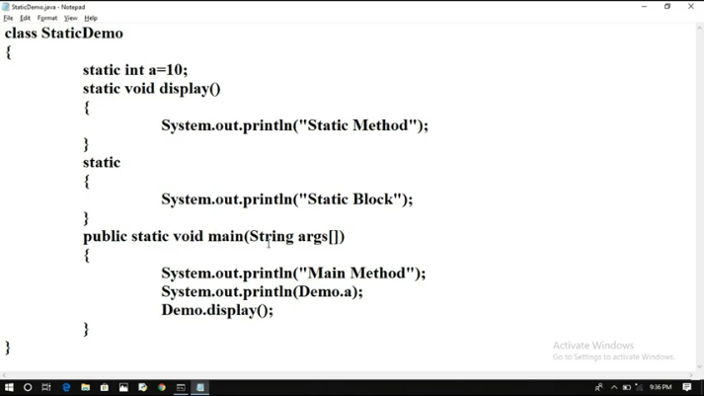
Static block with the same class
Output:
Static block
Main Method
10
Static Method

